Slide 1
Embodied AI — Week 21
A new focus, a paper, and a workshop series — Shaoqin Li

Slide 2
Today's Story
From a compute ceiling, to a new direction, to a workshop series for Prof. Sun
› What my laptop can actually do — and the evidence behind the compute-ceiling verdict
› New focus: video → robot retargeting — and how it's a different pipeline stage from Mario's work
› One paper on this topic, read the way I now read all of them
› The CUNY AI workshop: a 6-experiment series, checked against Prof. Sun's actual brief
Embodied AI — Week 21

Slide 3
What My Laptop Can Actually Do
GTX 1650 · 4GB VRAM · 4 cores · WSL2
› Diagnosis & evaluation: YES — the sim2sim root-cause work, the lockstep harness fix (2.42s → 5.76s), and 5 controlled training experiments all ran here
› Robust training at scale: NO — 5 separate experiments (reward redesign, jitter DR, deploy-exact model, and more) all showed gains on the training curve but zero real-harness transfer
– Every one landed in the same 1.7–2.8s survival cluster on the real DDS harness, regardless of which lever was pulled
› Mechanism: single-environment PPO can't average out the variance of domain-randomized returns — a compute ceiling, not a training-time problem
› This week's own probe (4 envs vs. 1) supports the same conclusion — see the workshop's "does compute matter" experiment
Verdict carried to Prof. Sun: training work is PAUSED, not abandoned, pending workstation access. Foreground shifted to laptop-viable work — the rest of this deck.
Embodied AI — Week 21 | Laptop Capability

Slide 4
What's Open On This Hardware
8 active 2026 G1/R1 research directions — sorted by whether they need training-scale compute
Direction | Status
1. Massively-parallel RL locomotion | Blocked — needs parallel envs
2. Multi-gait unified controllers | Blocked — needs parallel envs
3. Motion tracking / imitation → my slice: kinematics-only retargeting | OPEN — chosen
4. Agile skills (fall recovery, parkour) | Blocked — needs heavier DR
5. Sim2real methodology (writeup) | OPEN — chosen
6. Whole-body loco-manipulation (Cesar: R1 door-opening) | Blocked — hardware + compute
7. Teleop as a data engine | Blocked — needs teleop rig
8. Humanoid VLA | Blocked — needs large pretraining
Embodied AI — Week 21 | Field Landscape

Slide 5
NEW FOCUS
Video → Robot Retargeting
The upstream pipeline stage the compute ceiling doesn't block

Slide 6
Why Video Retargeting
› The problem: turning ordinary video into motion a humanoid can execute
› No RL training loop involved — kinematics + heuristics only, so the single-env compute ceiling doesn't apply here
› Almost no published work targets Unitree R1 specifically — every retargeting paper I've found uses G1 or H1/H1-2. An open niche for this lab
› Feeds directly into imitation/RL pipelines — including Mario's — as a reusable upstream input, not a competing effort
Embodied AI — Week 21 | Video Retargeting

Slide 7
Not Duplicating Mario
Two different pipeline stages
VIDEO
RETARGETING (me)
RL + IL TRAINING (Mario, Isaac Lab)
DEPLOYED POLICY
› R1-specific kinematic mapping — no published R1 retargeting exists yet [CORE]
› Non-learned physical-plausibility filtering — contact / joint-limit / self-collision checks, no RL [CORE]
› Reusable retargeted-motion library — a deliverable Mario's RL+IL could consume later
› In-the-wild video robustness — occlusion, off-angle shots, multi-person scenes
› Cross-embodiment R1-vs-G1 comparison — ties directly into the sim2real-methodology writeup
Embodied AI — Week 21 | Video Retargeting

Slide 8
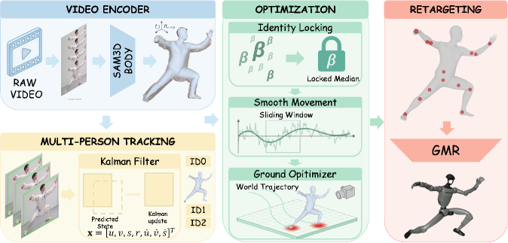
FEATURED PAPER
World-Coordinate Human Motion Retargeting via SAM 3D Body
Tu, Su, Zhu, Zheng · arXiv 2512.21573 · target platform: Unitree G1
Embodied AI — Week 21 | Featured Paper

Slide 9
FEATURED PAPER · 1 OF 5
Problem & Core Idea
› Per-frame 3D pose estimators place a person correctly relative to the CAMERA — not in the real world
› No guarantee of a fixed skeleton size, or that feet actually touch the floor
› Core idea: wrap a frozen, off-the-shelf pose estimator (SAM 3D Body) with three cheap fixes — lock skeleton size, smooth pose in a compact latent code, physically ground the feet
› Then retarget onto a Unitree G1 — no SLAM system required
Embodied AI — Week 21 | Featured Paper

Slide 10
FEATURED PAPER · 2 OF 5
Core Challenges
Camera-frame vs. world-frame
Skeleton drift across frames
Feet sliding through the floor
A photo tells you a joint angle, not whether the person is walking across a room — especially if the camera itself is moving.
Independent per-frame estimates make bone lengths wobble — like a tailor re-measuring the same person differently every few seconds.
Kinematics alone has no notion of gravity — feet can glide or clip through the ground like a puppet on ice.
Embodied AI — Week 21 | Featured Paper

Slide 11
FEATURED PAPER · 3 OF 5
Method
› Frozen SAM 3D Body extracts per-frame MHR pose codes
› SORT + Kalman tracking keeps identities straight across frames and people
› Shape-locking averages and freezes skeleton size
› Sliding-window optimizer smooths the compact latent code (not raw joint coordinates)
› Differentiable contact model grounds the feet while solving for world trajectory
› Two-stage IK retargets 14 matched joints onto the G1
Figure 1 — full pipeline, as published
Embodied AI — Week 21 | Featured Paper

Slide 12
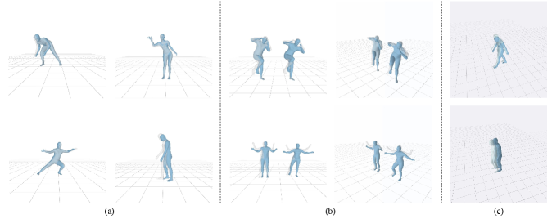
FEATURED PAPER · 4 OF 5
Results — read honestly
ZERO quantitative results, baselines, or ablations. Qualitative-only evidence — this is the headline, not a footnote.
› Visual figures show stable single- and multi-person reconstruction
› And reduced foot-sliding vs. the unrefined estimate
› No evidence a controller was ever run on the retargeted G1 output
› No code or project page released
Figure 2 — qualitative results (a) single-person (b) multi-person (c) contact refinement
Embodied AI — Week 21 | Featured Paper

Slide 13
FEATURED PAPER · 5 OF 5
Why It Matters — to my own pipeline
› A genuinely lightweight recipe — no SLAM, no heavy transformer
› Close to a reference architecture for a kinematics-only retargeting pipeline
› But the lack of quantitative validation means I'll need my own plausibility metrics before trusting it as a data source
› That gap is exactly sub-direction #2 from three slides ago — non-learned physical-plausibility filtering
Embodied AI — Week 21 | Featured Paper

Slide 14
CUNY AI PROGRAM
Embodied AI Workshop
A 6-experiment series for beginners — checked against Prof. Sun's actual brief

Slide 15
6 Experiments, Checked Against The Brief
Simulator-only · targeted at embodied AI training · ≥4 required (more welcome) · easy → advanced · integration optional
# | Experiment | Type | Literally “training”?
1 | Stand without RL — kp/kd tuning | Control | No — pre-training baseline
2 | Train your first policy | Training | Yes
3 | Reward shaping & the robotic walk | Training | Yes
4 | Does compute matter? | Training | Yes
5 | The sim2sim gap, live (capstone) | Transfer / Eval | Yes — evaluates training's output
6 | Human video → robot motion (bonus) | Data pipeline | No — advanced / Mario tie-in
Arc: control baseline → learning → transfer & scale → (bonus) data pipeline. #5 moved from mid-series to capstone — it's the conceptually hardest item, so it reads better as the reveal than a middle step.
Embodied AI — Week 21 | Workshop Overview

Slide 16
CUNY WORKSHOP · EXPERIMENT 1 OF 6
Stand Without RL
BEGINNER
› What students do: open the R1 standing model in the MuJoCo viewer; live-adjust kp (stiffness) and kd (damping) on a joint and watch the robot hold — or lose — its balance
› What they learn: a PD controller is just a spring + damper; standing is possible with the right gains and zero learning — which motivates why we need RL for anything harder
PD control at one joint
torque = kp · (target − position) − kd · velocity
turn kp up → stiffer, snappier, can overshoot turn kd up → mushier, more damped, can't react fast
Embodied AI — Week 21 | Workshop · Exp. 1

Slide 17
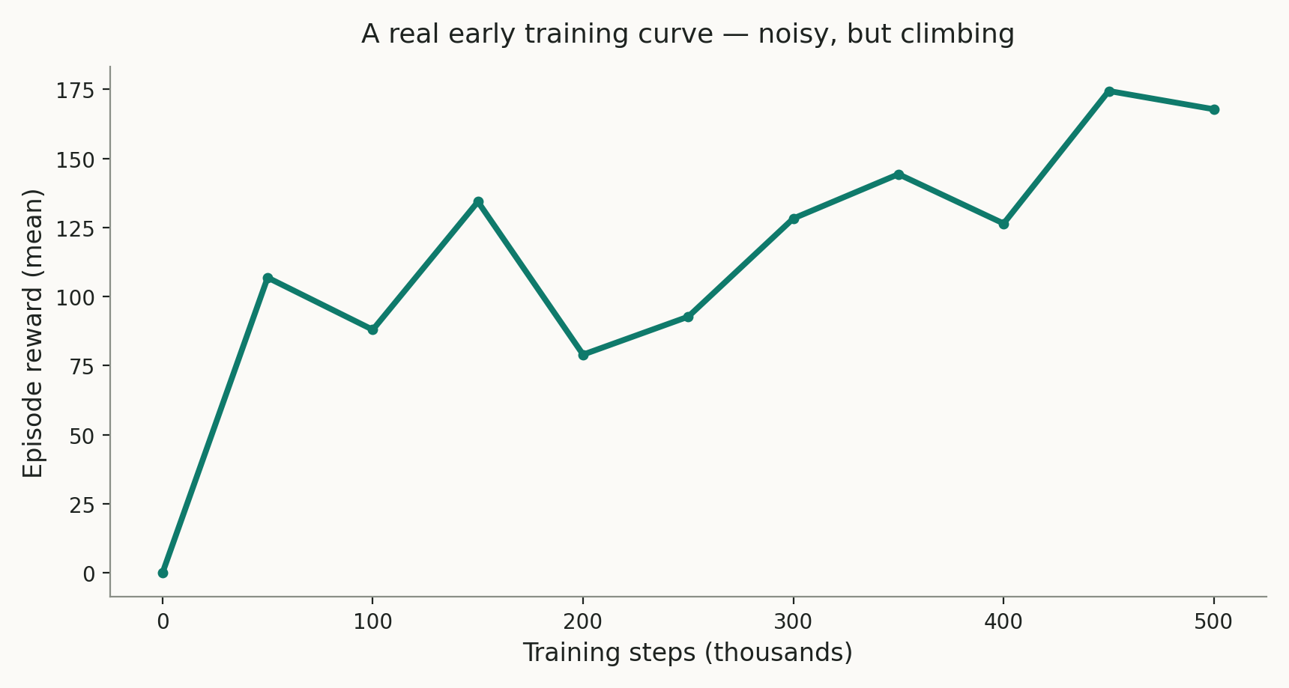
CUNY WORKSHOP · EXPERIMENT 2 OF 6
Train Your First Policy
BEGINNER+
› What students do: launch a short PPO run on the R1 standing task — minutes on a laptop — and watch the live reward curve
› What they learn: what “learning” looks like as a number going up, noisily; compare an early checkpoint's flailing to a late checkpoint's stability
A real early training curve — noisy, but climbing
Embodied AI — Week 21 | Workshop · Exp. 2

Slide 18
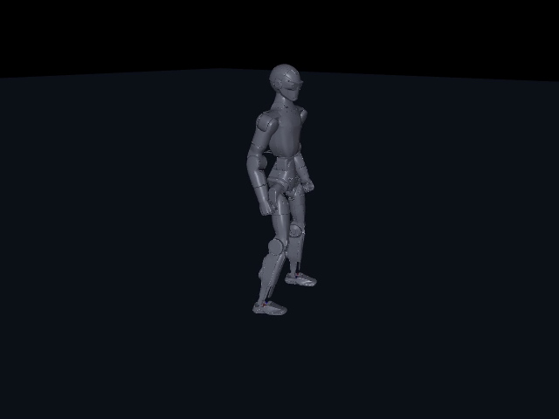
CUNY WORKSHOP · EXPERIMENT 3 OF 6
Reward Shaping & The Robotic Walk
INTERMEDIATE
› What students do: take a working walking policy, change one reward term (e.g. remove the torque penalty), retrain briefly, watch the walking style change
› What they learn: RL optimizes exactly what you reward, not what you intend
› A torque-averse reward produces a shuffling, low-margin gait — the instructor's own walk1-vs-walk3b comparison is the worked example
walk3b — the trained result students will be reshaping
Embodied AI — Week 21 | Workshop · Exp. 3

Slide 19
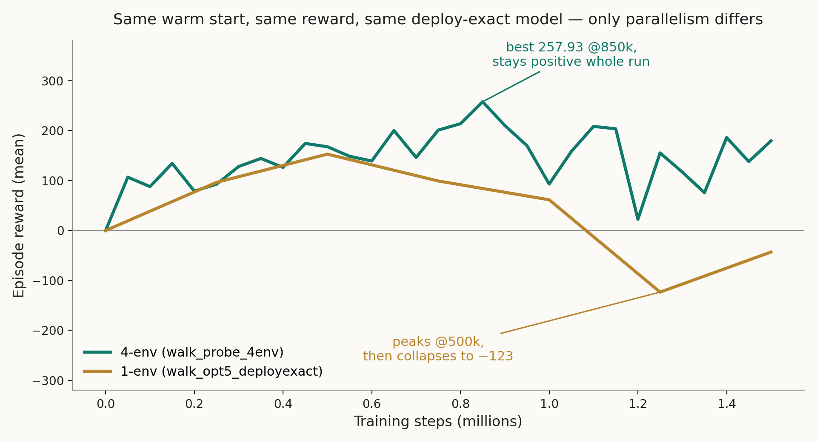
CUNY WORKSHOP · EXPERIMENT 4 OF 6
Does Compute Matter?
INTERMEDIATE
› What students do: compare two provided training logs — one single-env run, one 4-env run, same warm start and reward
› What they learn: more parallel environments measurably stabilizes training — this week's own probe result
› Ties to a published finding (RGMT): compute/data efficiency is an active, solvable research question — not just a hardware excuse
Embodied AI — Week 21 | Workshop · Exp. 4

Slide 20
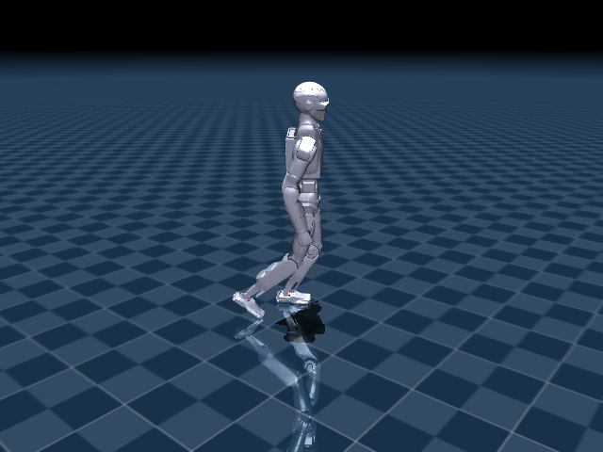
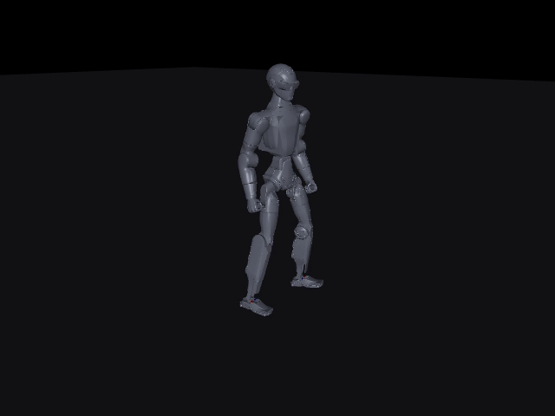
CUNY WORKSHOP · EXPERIMENT 5 OF 6
The Sim2Sim Gap, Live
ADVANCED · CAPSTONE
› What students do: watch ONE trained policy run in three settings, and hypothesize why before the reveal
› What they learn: a gap between simulators isn't always physics — this one was CONTROL-LOOP TIMING, not “reality”
Clean batch sim — 20s, full success
Real DDS harness — falls ~2.4s
Lockstep fix — 5.76s, exact same physics
Embodied AI — Week 21 | Workshop · Exp. 5 — the signature demo

Slide 21
CUNY WORKSHOP · EXPERIMENT 6 OF 6
Human Video → Robot Motion
ADVANCED · BONUS
› What students do: run a short video of a person walking through pose estimation (MediaPipe), retarget the skeleton onto the R1's joints, replay it in MuJoCo
› What they learn: how motion actually gets from a phone camera to a robot joint command
VIDEO
MEDIAPIPE POSE
RETARGET TO R1
MUJOCO REPLAY
Same pipeline stage as this week's featured paper — and the natural bridge into Mario's imitation-learning module.
Embodied AI — Week 21 | Workshop · Exp. 6

Slide 22
NEXT STEPS
› Check the pending walk_probe_4env lockstep result
› Start Phase 0 of the R1-specific retargeting pipeline (kinematic mapping + plausibility filtering)
› Draft the written one-page-per-experiment proposal for Prof. Sun
› Keep chasing workstation (RTX 5080) access
Questions?
Embodied AI — Week 21

